Slide 1

MUSIC RECOMMENDATION SYSTEM USING K-MEANS
GROUP 2
Abeesh Thampi Krishnapillai Janardhananpillai
Altamash Arif Karlekar
Harpreet Kaur
Priyanka Awasthi
Sudhan Manovah Manivannan

Slide 2
Objective
To build a playlist for music lovers with songs recommendation list using k-means algorithm.
Project Summary
Users today find it challenging to locate obscure but intriguing tracks due to the increasing growth of digital music on online. Music plays a very critical role in a everyone’s life and a great amount of effort goes in music recommendation. We have chosen to use an unsupervised learning problem to build a recommendation system to suggest songs to users based on the clustering.

Slide 3
Scope and Algorithm
Users get recommendation of songs depending on their tastes in various genres of music as well as song features. K-Means Clustering is an unsupervised machine learning algorithm which is used to solve the clustering problems in data science.
This algorithm groups the unlabelled dataset into various clusters, in this approach K defines the number of pre-defined clusters that need to be created, for example if K=10, there will be ten clusters, this is a centroid-based algorithm, where each cluster is associated with a centroid, the primary focus is to minimize the sum of distances between the data points and their respective clusters.
The algorithm takes the unlabelled dataset as input and divides the dataset into k-number of clusters, this process repeats until it does not find the best clusters and the value of k should be predetermined in this algorithm.

Slide 4
Data Collection
We used Kaggle dataset for building the recommendation and used Spotify data, which is publicly available, to test our recommendation system. The Kaggle data sets are collected into our local machines from various sources and the files are imported in python.
The three files contain Song Data, Data by Genre and Data by year, in the end we have a dataset with approximately 170K songs and 2973 genres. Furthermore, we considered features such as Acousticness, Danceability, Energy, Instrumentalness, Liveness, Loudness, Speechiness, Tempo, Valence, Duration, Explicit, Key, Mode, Year as features.

Slide 5
Features Correlation
We checked with all the analysis by keeping target as ‘Popularity’, we also checked Feature Correlation among Popularity and other features by using yellowbrick package.
Based on the correlation map, we noticed that year plays a significant role in popularity, hence we used year-based songs as priority to build our music recommendation system.
To understand music over time, we considered the data grouped by year to notice how the overall sound of music has changed from 1921 to 2020. Next, to understand characteristics of different Genres, the dataset contains the audio features for different songs along with the audio features for different genres. We used this information to compare different genres and understand their unique differences in sound.

Slide 6
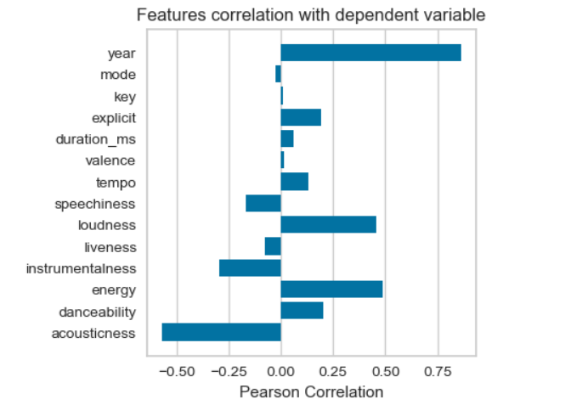
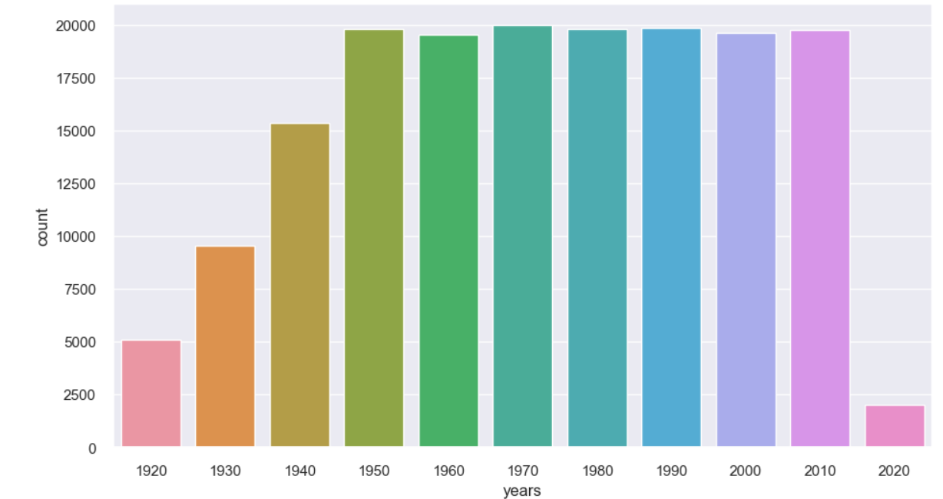
Features correlation
Music Over Time

Slide 7
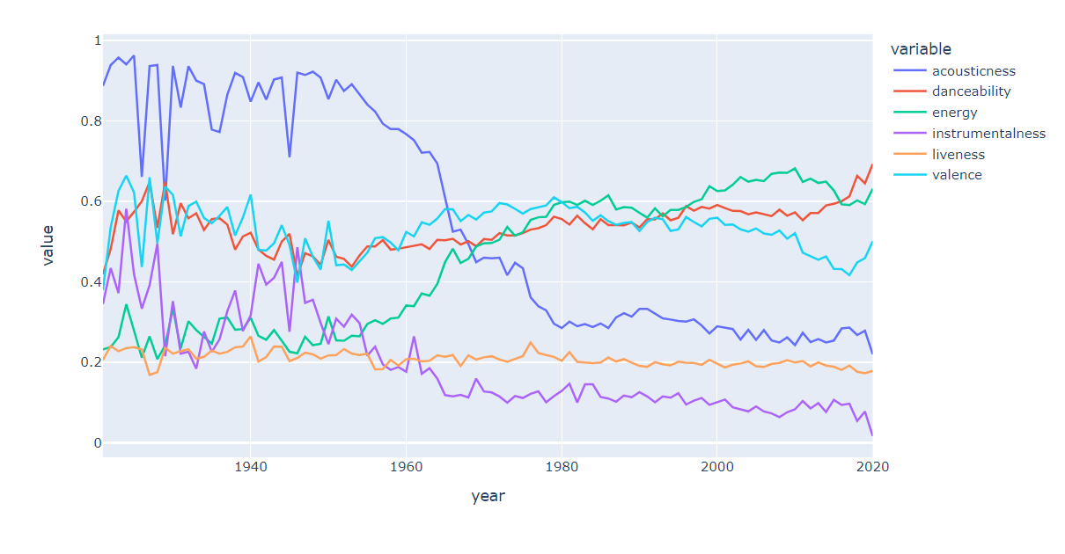
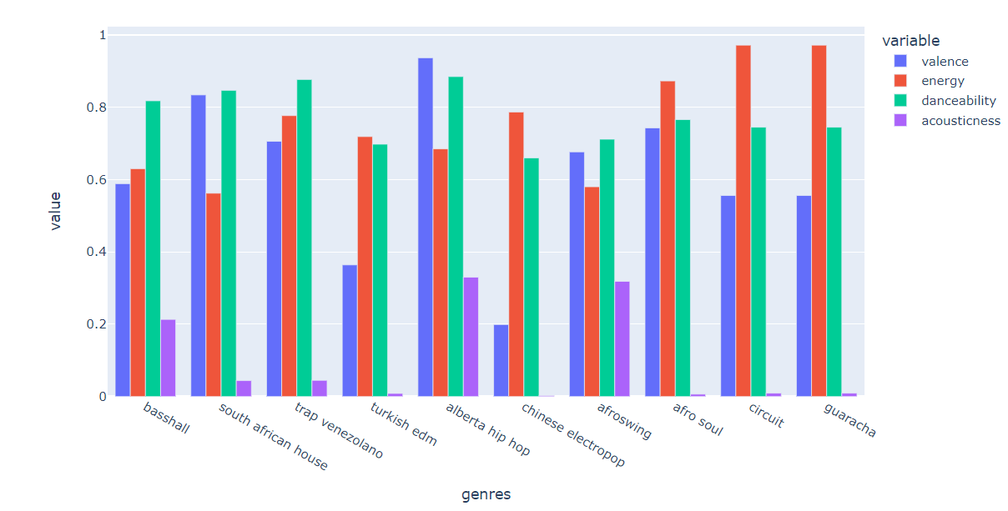
Understanding the Dataset

Slide 8
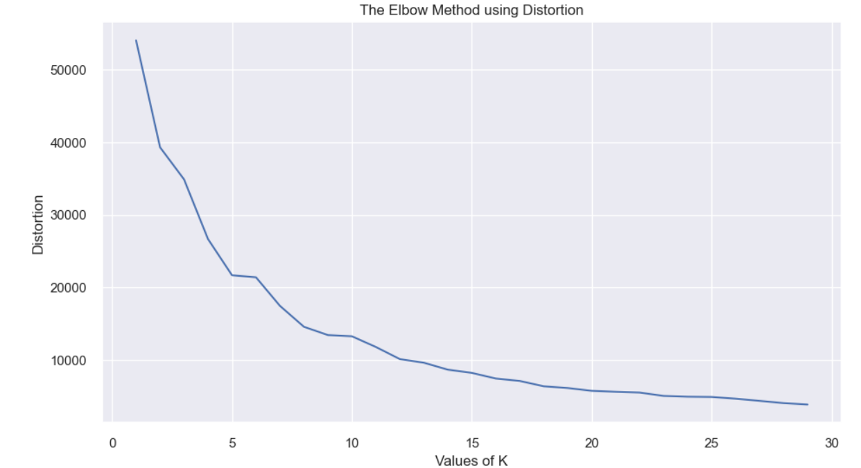
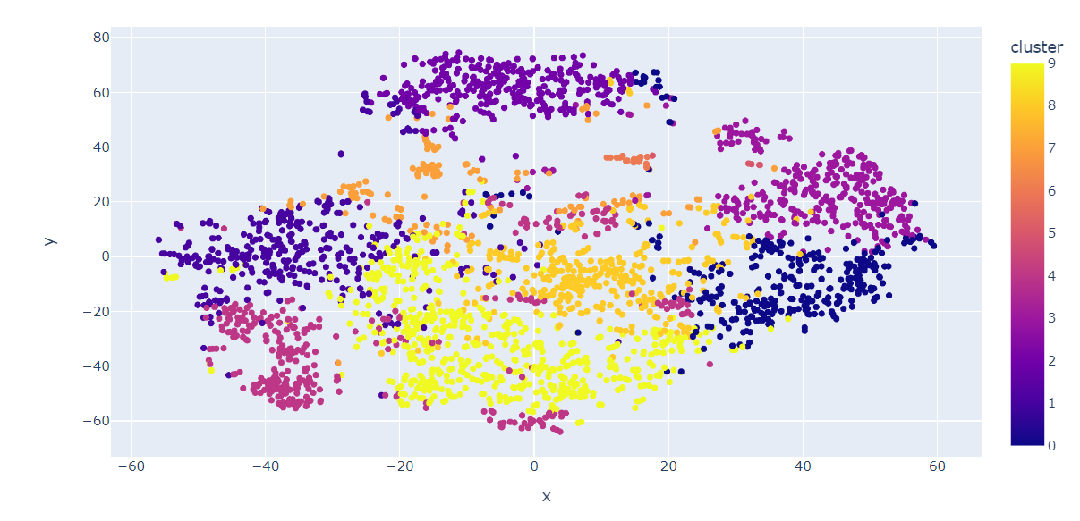
Clustering Genres With K-means
Elbow Method is used to identify number of clusters then K-means clustering algorithm to divide the genres in the dataset. Here, K was identified as 10 to run K –means

Slide 9
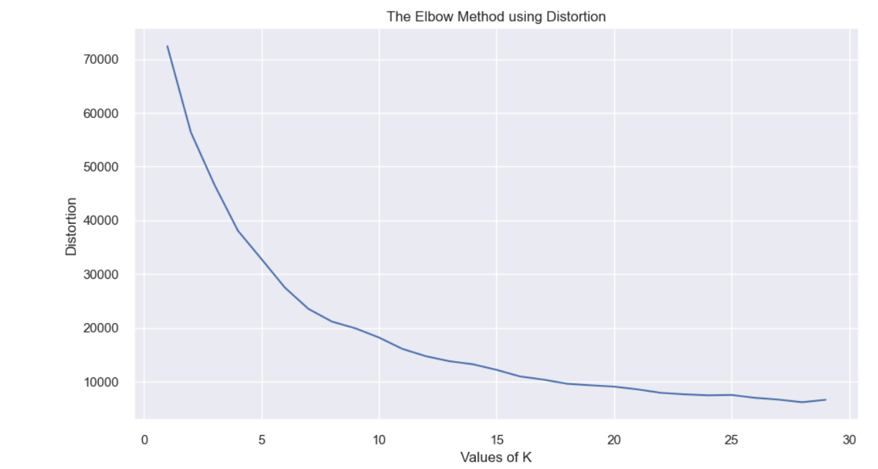
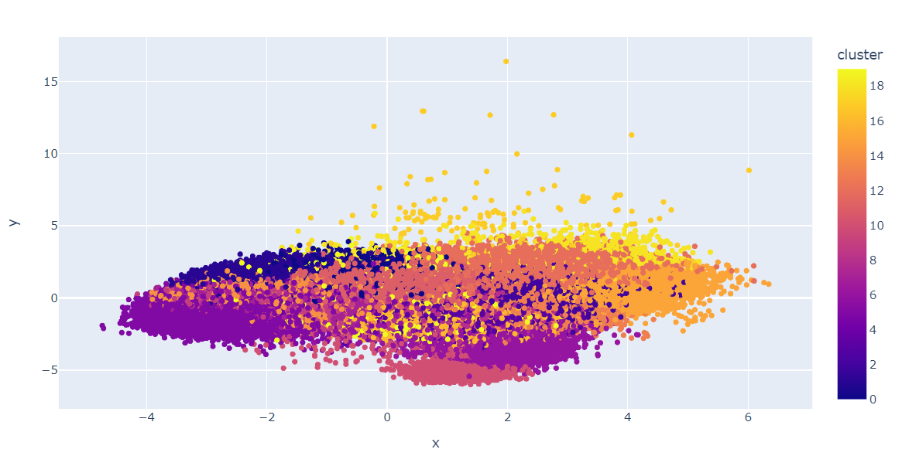
Clustering Songs With K-means
Elbow Method is used to identify number of clusters then K-means clustering algorithm to divide the songs in the dataset. Here, K was identified as 20 to run K –means.

Slide 10
The Recommendation
Based on the analysis and visualizations, it’s clear that similar genres tend to have data points that are located close to each other while similar types of songs are also clustered together.
Similar genres will sound similar and will come from similar time periods while the same can be said for songs within those genres. This concept is used to build a recommendation system by taking the data points of the songs a user has listened to and recommending songs corresponding to nearby data points.

Slide 11
Reinforcement Learning Based Playlist Recommendation Model
Reinforcement Learning is applicable to recommend music to users, reinforcement learning can be employed to learn user preferences from their song playing log.
Recommendation system can be modelled as Markov decision process, and reinforcement learning can be employed to solve it. The user feedback can be integrated into model as well as considering the influence between songs.
“A state compression method can be used to capture enormous state space of MDP. A recommendation strategy is designed to make a trade-off between accuracy and coverage of recommendation.”
Citation: https://link.springer.com/chapter/10.1007/978-3-319-68121-4_18#Sec3
https://link.springer.com/article/10.1007/s11042-019-08356-9

Slide 12
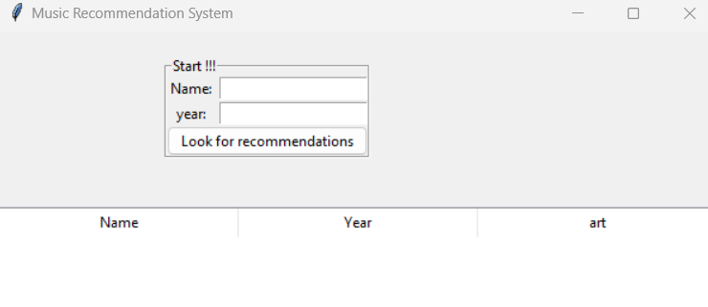
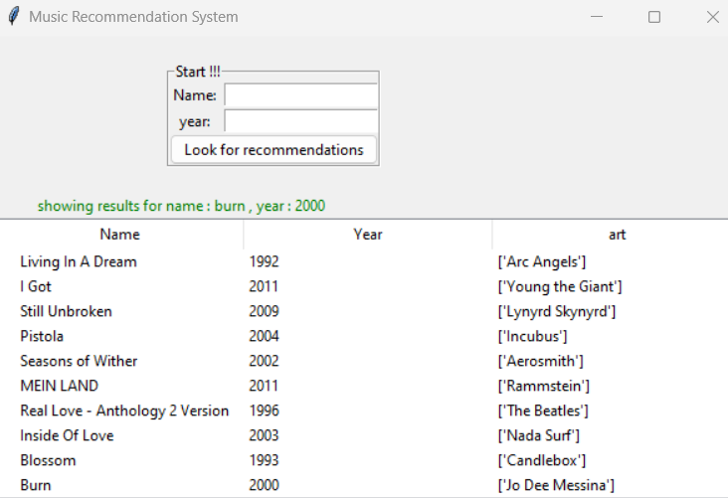
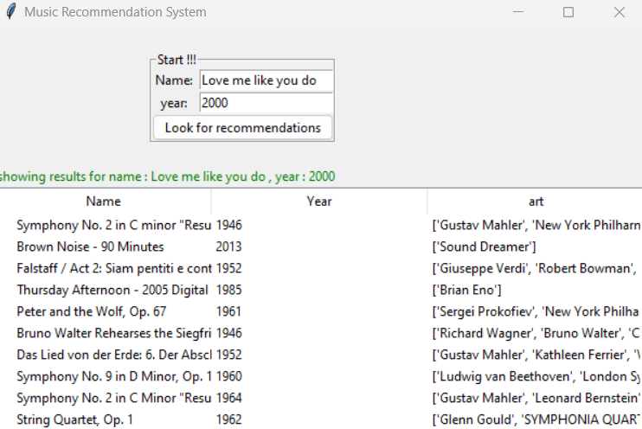

Slide 13
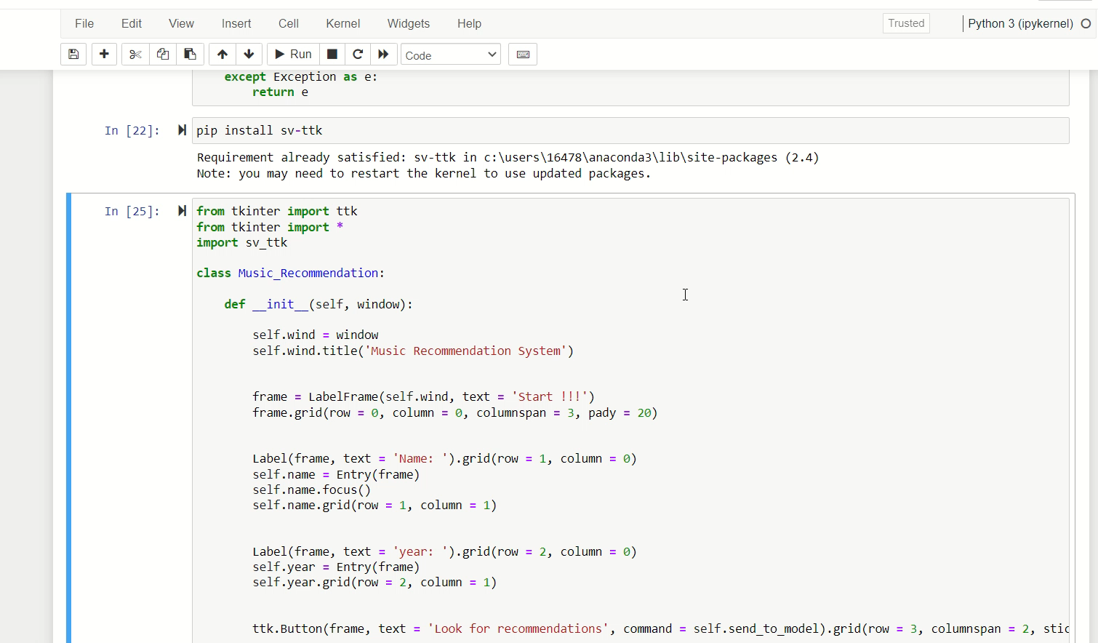

Slide 14
References and Citation:
https://www.kaggle.com/search?q=music+recommendation
https://www.researchgate.net/publication/306007001_A_Novel_Hybrid_Music_Recommendation_System_using_K-Means_Clustering_and_PLSA
https://ffs97.github.io/includes/files/k-collaborative-filtering.pdf
http://web.stanford.edu/~agrim/pdfs/cs221-project-final.pdf
https://medium.com/@shashwatdixit6311/content-based-music-recommendation-system-9db1245a04ea
https://www.researchgate.net/publication/228618921_A_literature_review_on_artificial_intelligence
https://www.researchgate.net/publication/354547481_Comprehensive_Review_of_K-Means_Clustering_Algorithms

Slide 15

THANK YOU

